Slide 1

“Improved algorithms for capturing Internet maps” Doctoral defense
Kévin Vermeulen
Sorbonne Université
June 2nd, 2020

Slide 2
Roadmap
Challenges
Diamond-Miner
Limited Ltd.
Conclusion

Slide 3
Internet
Notes:
What is mapping the Internet? Mapping the Internet consists in revealing the nodes and the links of the internet infrastructure. Why is hard to map the Internet? Today, nobody can give you a map of the Internet. The Internet is composed of tens of thousands of autonomous systems, or Ases.

Slide 4
AS1
AS2
AS3
AS4
Notes:
According to the RFC 1930 “an AS is a connected group of one or more IP prefixes run by one or more network operators which has a SINGLE and CLEARLY DEFINED routing policy.”
Inside and between ASes, there are interconnected routers that are connected through their interfaces.
Routers interconnections are called router level topology, and interface interconnections are called IP level topology.
Network operators often hide their network topology, as it is often considered as an industrial secret.
To reveal it, researchers have to perform measurements from vantage points connected to the Internet.
This thesis proposes new measurements techniques to better capture both IP and router level topology.

Slide 5
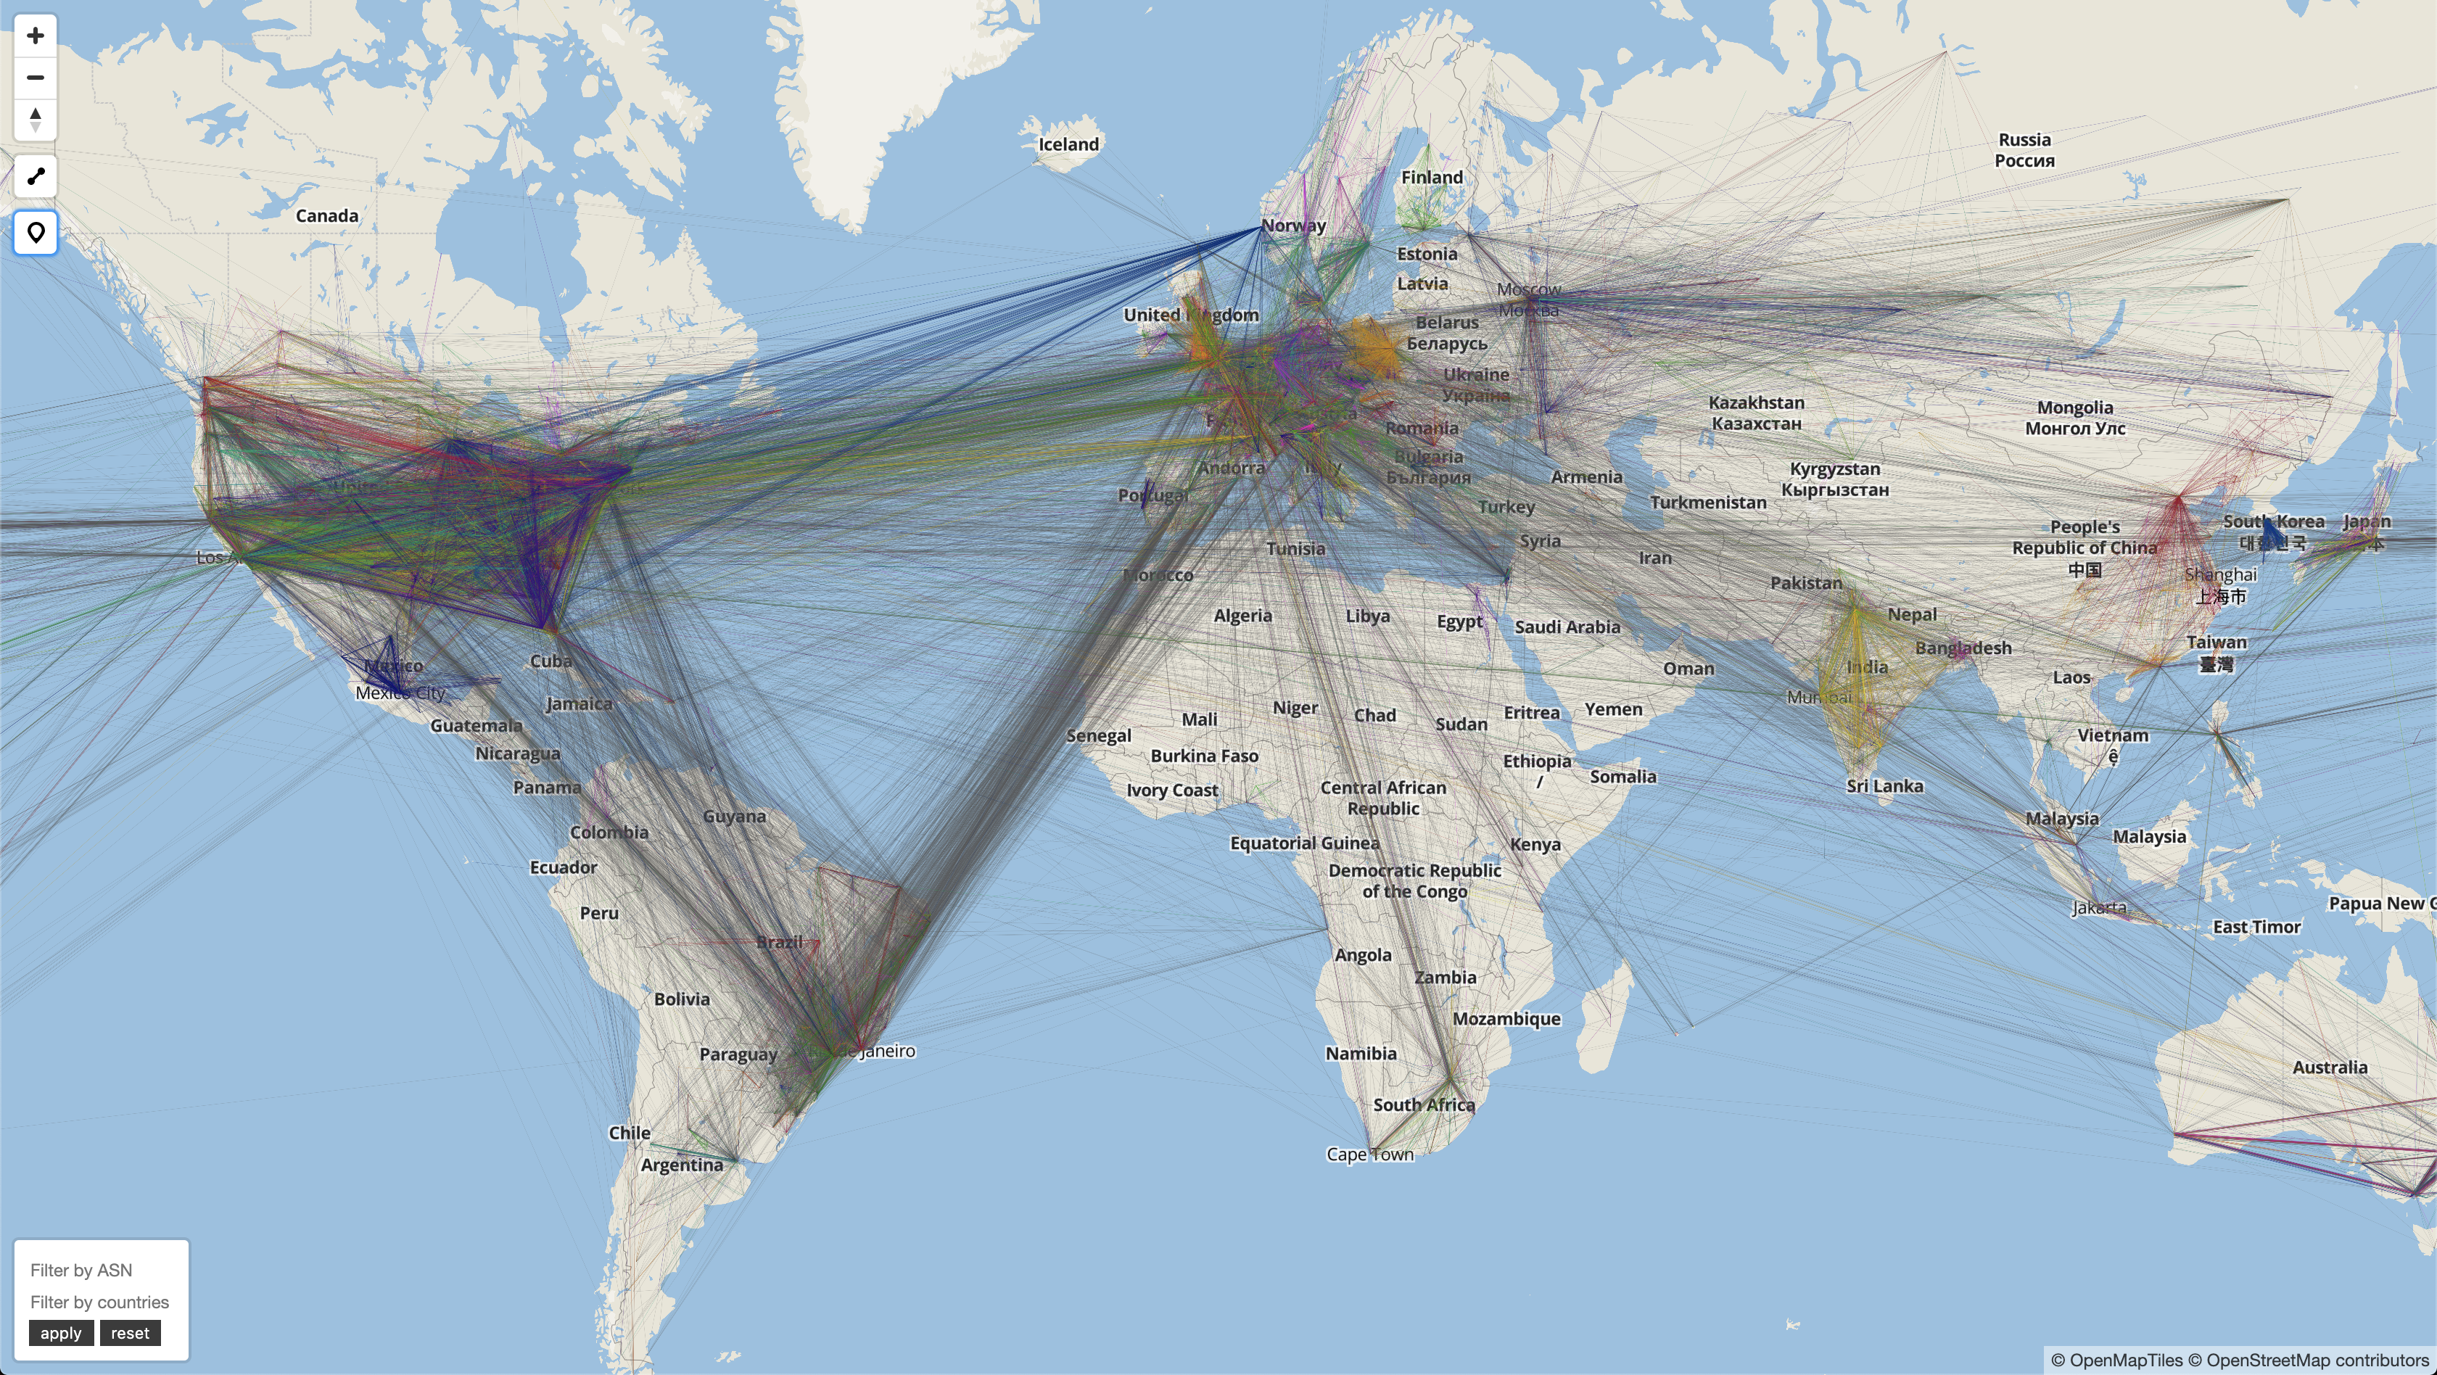
Motivation
Cybersecurity
Socio-economic
Resilience
Basic science
Notes:
Why do we want to capture the Internet topology?
At a high level, knnowledge of the Internet topology supports the understanding of Internet societal implications
Internet topology, coupled with router geolocation, gives you information about what countries your traffic is crossing.
if you have sensitive data, you may not want this traffic to be intercepted by a country that you’re not trusting.
Better understand the Internet ecosystem. Which and where autonomous systems are interconnected?
Resilience. For example, if you do not have thee full view of load balanced paths that lead to a destination, you could have a misinterpretation of the robustness towards outages
Last but not least, challenge in itself as basic science

Slide 6
AS1
AS2
AS3
AS4

Slide 7
AS3
AS4
Notes:
Let’s focus on one path between a source and a destination and give you an historical overview.

Slide 8
20 years ago
VP
/24
TTL 1
TTL 2
TTL 3
TTL 4
TTL 5
Notes:
20 years ago, between our source and our destination, it would probably look like this. A single path between the source and a destination.
To reveal it, you would use traceroute. Traceroute was basically designed for debugging and troubleshooting purposes, and it it doing so by revealing the interfaces on the path between a source and a destination.
Traceroute is a tool that sends TTL limited probes to trigger ICMP TTL exceeded replies from the routers on the path.
So here it would first send a probe at TTL 1, then at TTL2, then 3, then 4, then 5, and finally trigger a response from the destination and would stop.
Each time it receives a reply, you can incrementally build the topology.
Traceroute gives you an IP level path between a source and a destination.
To reveal the router level path, you have to perform other techniques, which are called alias resolution techniques, and I’ll get back to this later. Let’s focus on IP level topology at the moment.

Slide 9
Router level topology
VP
VP
/24
TTL 1
TTL 2
TTL 3
TTL 4
TTL 5

Slide 10
IP level topology
VP
VP
/24
TTL 1
TTL 2
TTL 3
TTL 4
TTL 5

Slide 11
20 years ago
VP
/24
TTL 1
TTL 2
TTL 3
TTL 4
TTL 5
Notes:
20 years ago, between our source and our destination, it would probably look like this. A single path between the source and a destination.
To reveal it, you would use traceroute. Traceroute was basically designed for debugging and troubleshooting purposes, and it reveals the topology between a source and a destination.
Traceroute is a tool that sends TTL limited probes to trigger ICMP TTL exceeded replies from the routers on the path.
So here it would first send a probe at TTL 1, then at TTL2, then 3, then 4, then 5, and finally trigger a response from the destination and would stop.
Each time it receives a reply, you can incrementally build the topology.
Traceroute gives you an IP level path between a source and a destination.
To reveal the router level path, you have to perform other techniques, which are called alias resolution techniques, and I’ll get back to this later. Let’s focus on IP level topology at the moment.

Slide 12
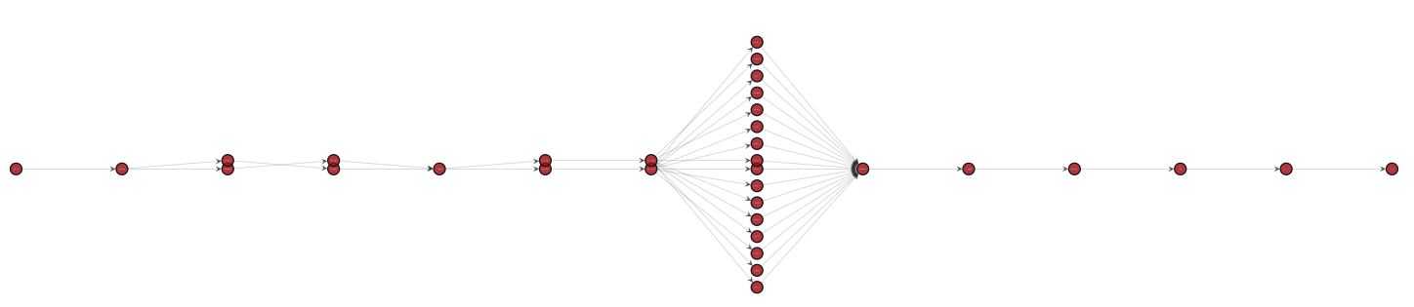
10 years ago
16 interfaces
VP
/24
Notes:
10 years ago, Internet paths were likely to look like this, with multiple paths leading to one destination
The reason for this is because of the presence of load balancing.
Load balancing is used to improve the resilience and the capacity of Internet paths.
I'm going to detail later how to capture this topology accurately.

Slide 13
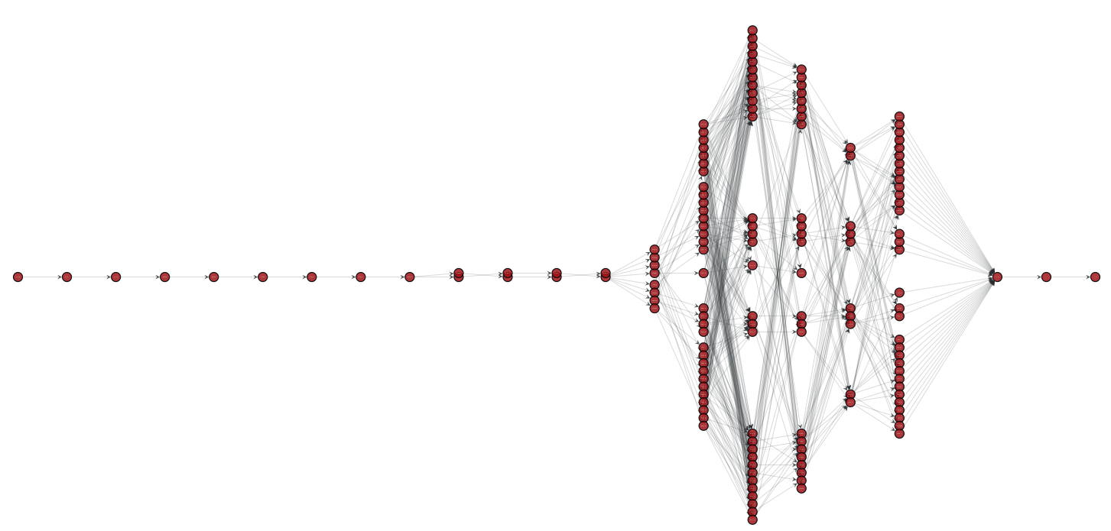
Today
32 interfaces
VP
/24
Notes:
Nowadays, the complexity of Internet paths has grown up.
They are really more complex than 10 years ago.
On this example, there are 32 interfaces at a single hop, and we can observe chained load balancing over subsequent hops.

Slide 14
Today
32 interfaces
VP
/24
Datacenter

Slide 15
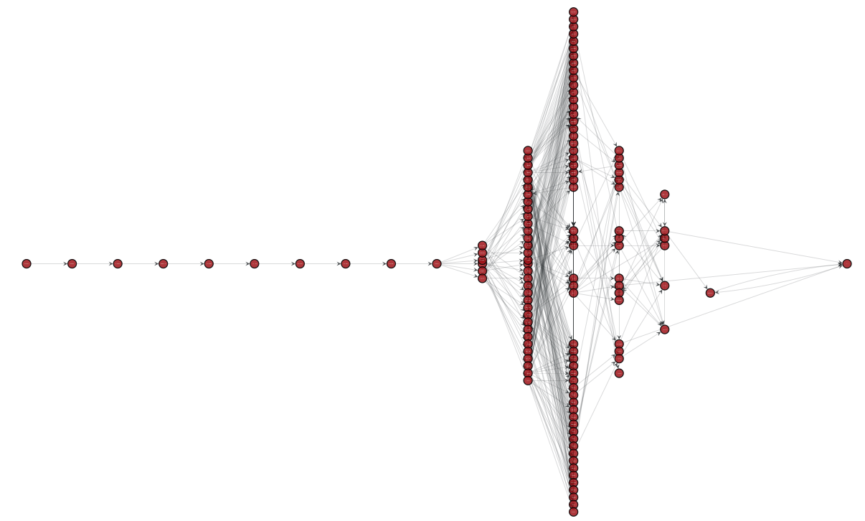
Today
55 interfaces
VP
/24
Tier 1

Slide 16
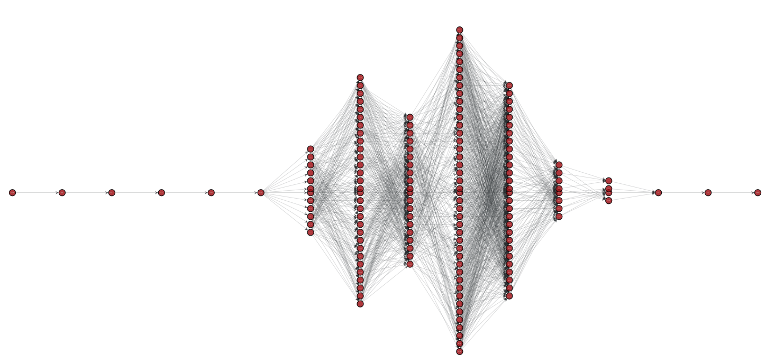
Today
42 interfaces
VP
/24
Large Cellular Provider

Slide 17
Time to capture a source/destination IP level topology
20 years ago: up to few seconds
10 years ago: up to tens of seconds
Today: up to tens of minutes

Slide 18
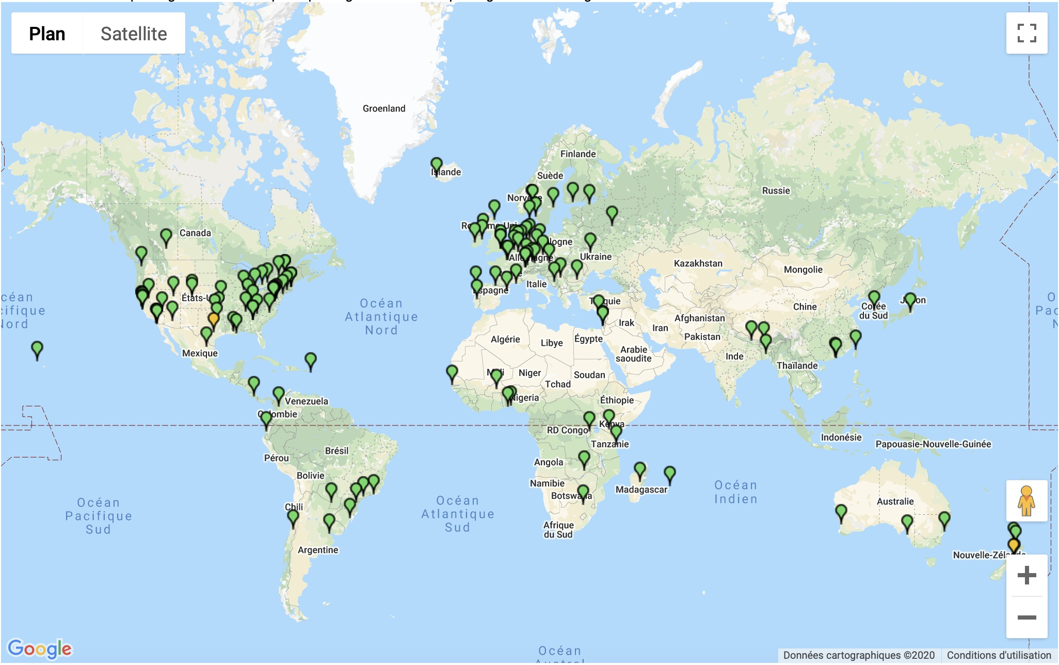
Ark (CAIDA, UCSD, ~110 VP)

Slide 19
Yarrp (Naval Postgraduate School, 15 VP in AWS)

Slide 20
Limitations of prior work
IP load balancing is even more prevalent than before, and everywhere in the Internet
No system to capture load balanced paths at Internet scale in a reasonable time
Bad idea of the true resilience and structure of the Internet

Slide 21
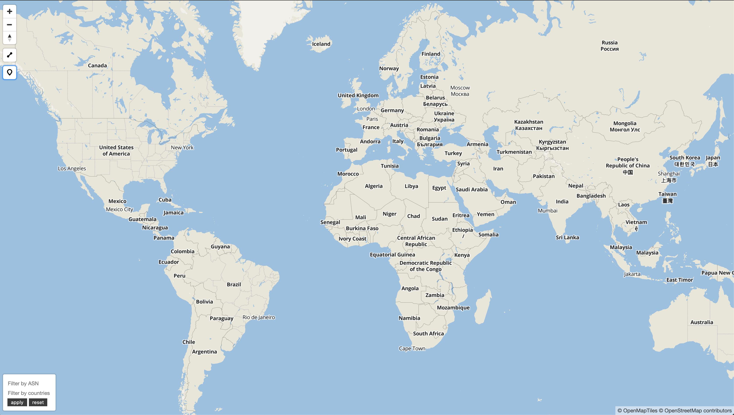
Notes:
Why is it hard? Because nobody gives you a map of the Internet. Internet is made of tens of thousands of interconnected autonomous systems, and these autonomous systems keep their topology hidden, as it is often considered as an industrial secret. Each color in this picture represents an AS.
To reveal it, researchers perform measurements from multiple vantage points.
The thesis that I am presenting today proposes new measurement techniques to better capture the Internet topology.

Slide 22
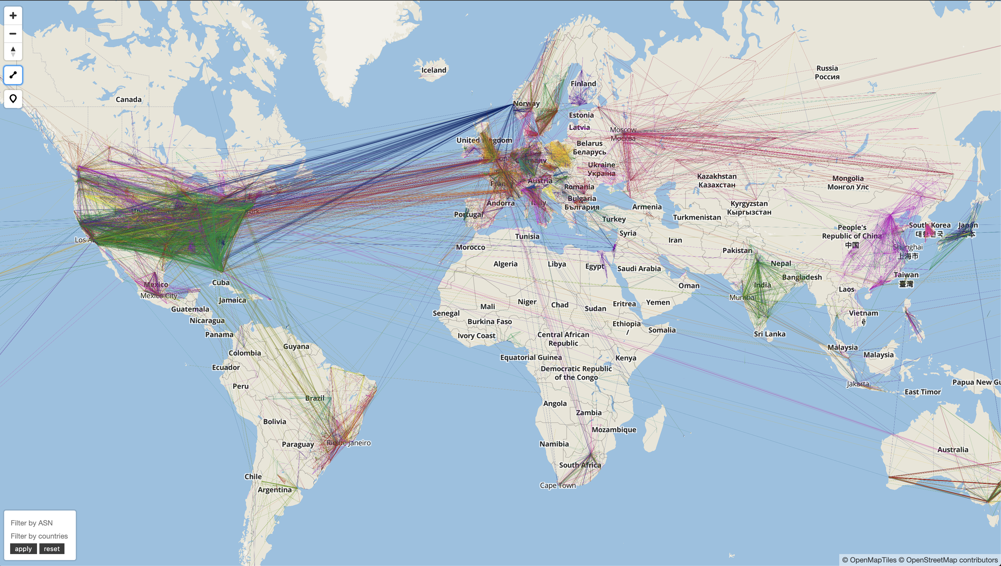
Notes:
Why is it hard? Because nobody gives you a map of the Internet. Internet is made of tens of thousands of interconnected autonomous systems, and these autonomous systems keep their topology hidden, as it is often considered as an industrial secret. Each color in this picture represents an AS.
To reveal it, researchers perform measurements from multiple vantage points.
The thesis that I am presenting today proposes new measurement techniques to better capture the Internet topology.

Slide 23
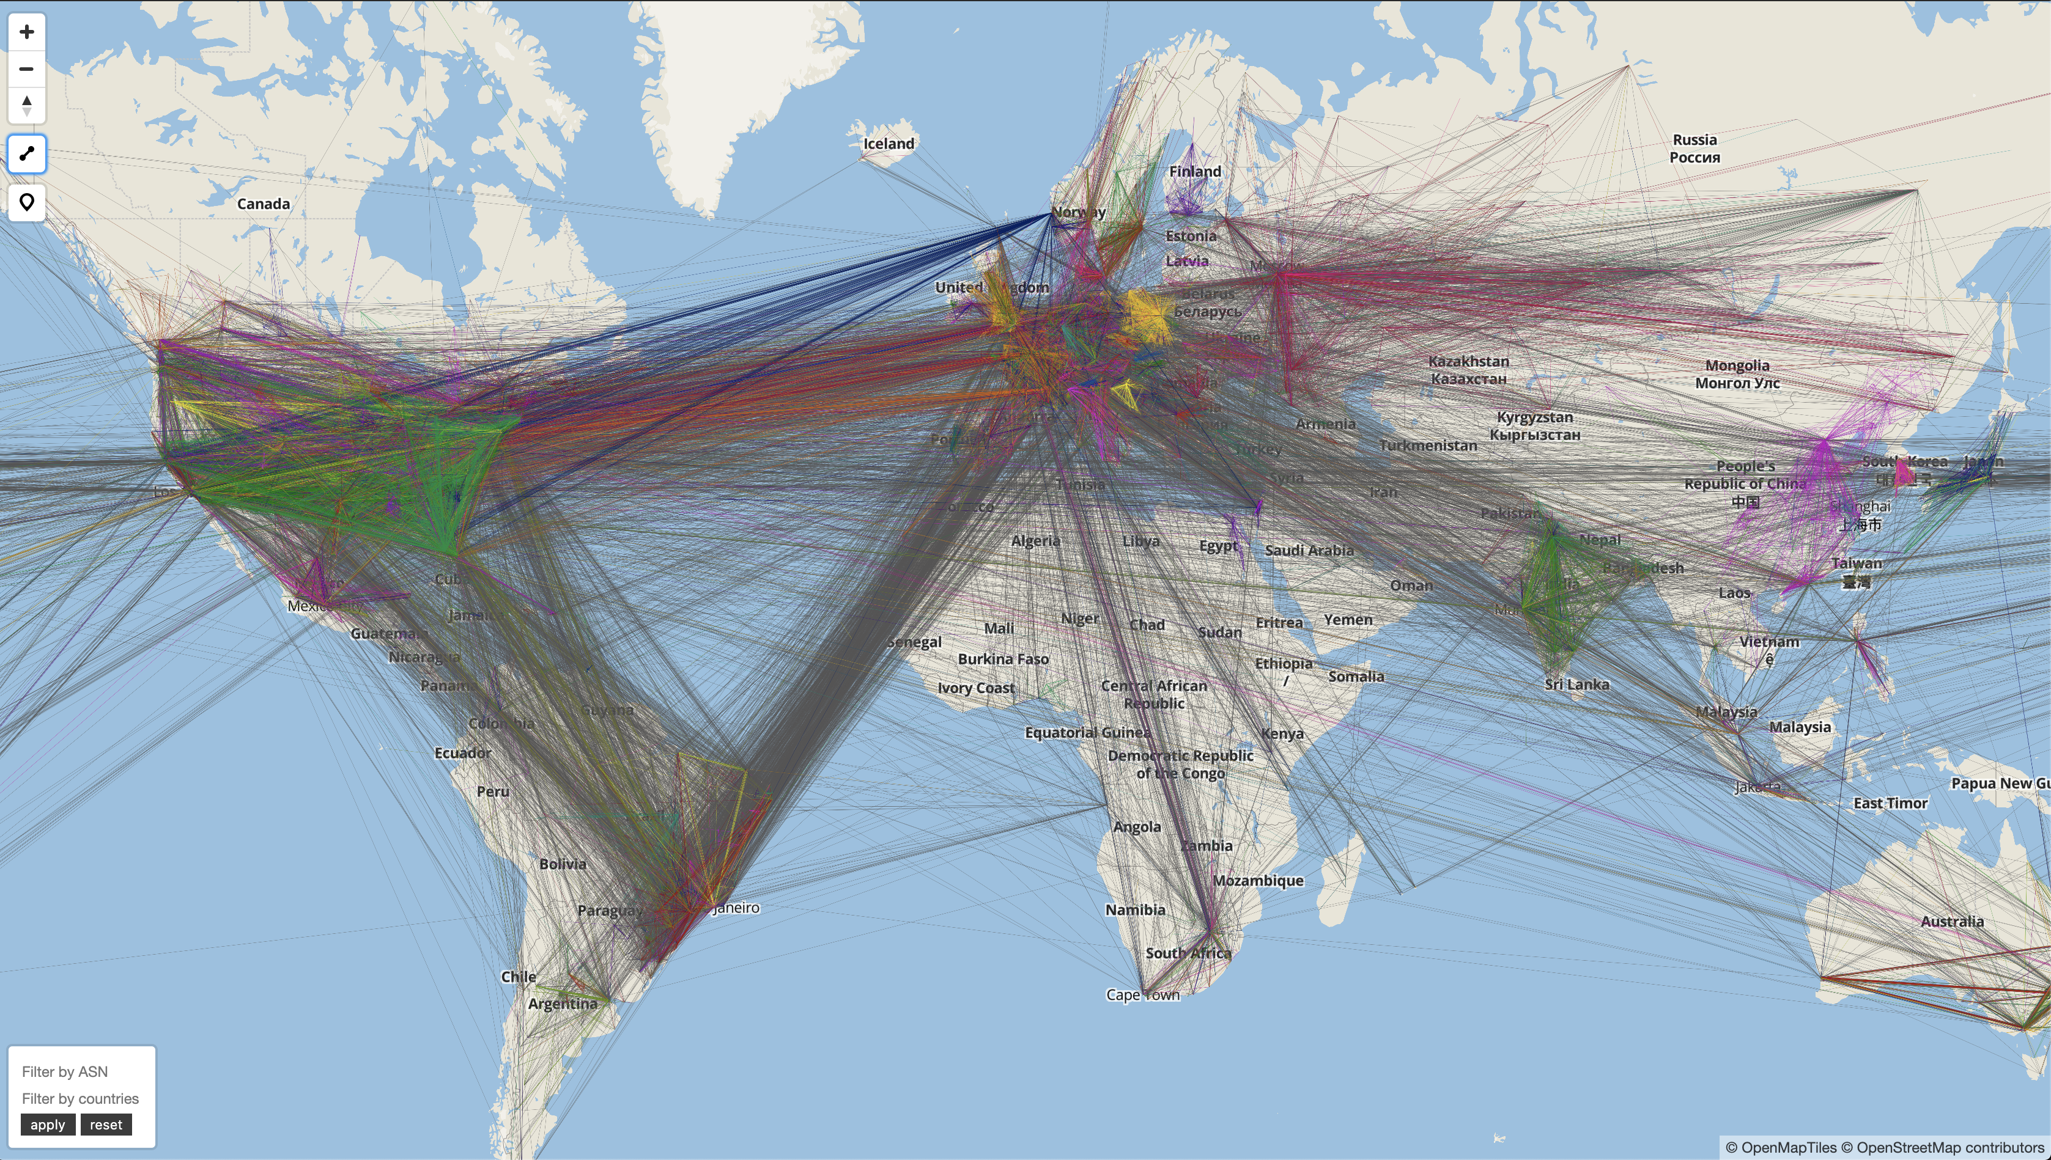
Notes:
Why is it hard? Because nobody gives you a map of the Internet. Internet is made of tens of thousands of interconnected autonomous systems, and these autonomous systems keep their topology hidden, as it is often considered as an industrial secret. Each color in this picture represents an AS.
To reveal it, researchers perform measurements from multiple vantage points.
The thesis that I am presenting today proposes new measurement techniques to better capture the Internet topology.

Slide 24
Roadmap
Challenges
Diamond-Miner
Limited Ltd.
Conclusion

Slide 25

Diamond-Miner: Comprehensive Discovery of the Internet’s Topology Diamonds
Kévin Vermeulen, Justin P. Rohrer, Robert Beverly,
Olivier Fourmaux, Timur Friedman
Notes:
This work has been done while I was a visiting researcher at NPS.

Slide 26

Notes:
There are millions of diamonds out there in the Internet, and we are not seeing them.
I'm going to show you today a system, diamond-miner, that allows you to see these diamonds.

Slide 27
Diamond
Notes:
By diamond, I mean the shape formed because of the presence of load balancing routers in the Internet.

Slide 28
Mapping diamonds today
Single path probing: traceroute, Paris traceroute
Multipath probing: MDA Paris traceroute
Notes:
Why aren't we seeing these diamonds?
Because in order to map these diamonds today, we have basically two options:
Either use single path probing technique, such as traceroute
Or use multipath probing technique, with MDA Paris traceroute
Both techniques can not completely capture the diamonds at Internet scale.
Let’s see first their limitations.

Slide 29
A toy example
B
C
VP
A
F
D
/24
E
G
Notes:
We will work with this toy example all along the presentation, and the goal will be to discover this topology, we do not know the topology in advance:
Let me introduce the notations:
VP = Vantage point
/24 is a destination prefix
The letters are IP interfaces
A is on a per destination load balancing router that is balancing traffic over two paths, through B and through E
E is on a per destination load balancing router that is balancing traffic over two paths, through F and through G.

Slide 30
Single path probing: traceroute, an incomplete technique
B
C
VP
A
F
D
/24
E
G
TTL 1
TTL 2
TTL 3
TTL 4
TTL 5
Notes:
The single path probing technique discovers diamonds inadvertently.
Let me explain.
You fix a destination in the /24 destination prefix and sends 1 probe per TTL. You will basically discover one path from VP to the destination prefix.
Because A is a per destination load balancer, you’re guaranteed that if you send probes with the same destination, they will follow the same path.
And when you send a probe with a destination that you have never used before, you have no idea of which path it will take.
Then, if you probe to another destination in the /24, because A is a per destination load balancer, eventually you will discover another path.
But you have no statistical guarantees that you have discovered all of them.
In order to obtain statistical guarantees, you have to use the multipath probing technique.

Slide 31
Multipath probing: MDA Paris traceroute, a hop by hop resolving technique
To resolve a node with 5% failure probability
Successors | 1 | 2 | …
Probes | 6 | 11 | …
B
C
VP
A
?
F
D
/24
E
G
TTL 1
TTL 2
TTL 3
TTL 4
TTL 5
Notes:
It's a hop by hop technique that progressively achieves statistical guarantees for every node discovered.
Let’s see how it proceeds.
Let’s say that we have discovered A at TTL 1, and now we are trying to discover the number of successors of A.
If I send one probe at TTL 2 with a destination in the /24 I will discover one interface, let's assume here it is B
If I send a second probe to hop 2 with a different destination, because it’s the first time I use this destination, I do not know which path it will take, so may be I will re-discover B.
Eventually, with a third destination I will discover E.
But nothing tells me that A has not a third successor, so I have to keep probing at TTL 2 until I reach a low failure probability that A has only 2 successors.
To obtain a failure probability of 5% that A has 2 successors, I have to send 11 probes through A at TTL 2.
Once I have sent these 11 probes and have discovered only 2 successors for A, I can say that the node A has been resolved.

Slide 32
Multipath probing: MDA Paris traceroute, a hop by hop resolving technique
To resolve a node with 5% failure probability
Successors | 1 | 2 | …
Probes | 6 | 11 | …
B
C
VP
A
F
D
/24
E
G
TTL 1
TTL 2
TTL 3
TTL 4
TTL 5
Notes:
Once A has been resolved, the algorithm steps to TTL 2, where it tries to resolve B and E.
To resolve B and E, I must send probes that go through B and through E.
By using the destinations that I used to find the successors of A, I know which paths they will take, so I if I send probes with the same destinations at TTL 3, I am able to discover the successors of B and E.
By doing so, I discover that B has 1 successor and E has 2 successors.
Therefore I need 6 probes that go through B and 11 that go through E to resolve them. At that point, B has been resolved but not E.
In order to resolve E, I have to find destinations that go through E, so I keep using new destinations until I get 11 that go through E.

Slide 33
Multipath probing: MDA Paris traceroute, a hop by hop resolving technique
To resolve a node with 5% failure probability
Successors | 1 | 2 | …
Probes | 6 | 11 | …
B
C
VP
A
F
D
/24
E
G
TTL 1
TTL 2
TTL 3
TTL 4
TTL 5
Notes:
The thing here to understand is that the algorithm proceeds TTL by TTL, node by node, because we want to send the minimum amount of probes to achieve the statistical guarantees. And this slows down the probing. On complex topologies, it can take several minutes to resolve all of the nodes of the topology, preventing the usage of this technique at Internet scale in a reasonable time.
Say that we do not send additionnal probes at TTL 3 that go through B

Slide 34
Multipath probing: MDA Paris traceroute, a hop by hop resolving technique
To resolve a node with 5% failure probability
Successors | 1 | 2 | …
Probes | 6 | 11 | …
B
C
VP
A
F
D
/24
E
E
G
TTL 1
TTL 2
TTL 3
TTL 4
TTL 5
Notes:
Finally, we resolve D at TTL 4, we see that all the nodes of the topology have been resolved so we mark this /24 prefix as resolved.

Slide 35
Mapping diamonds today
Single path probing: traceroute, Paris traceroute
→ No statistical guarantees
Multipath probing: MDA Paris traceroute
→ No Internet scale
How to build a system that provides statistical guarantees at Internet Scale?
Notes:
As we have seen, both of the current techniques are not able to capture the diamonds at Internet scale with statistical guarantees.
Single path probing technique because it offers no statistical guarantees on the discovery
Current Multipath probing technique because it resolves the nodes TTL per TTL, prevent its usage at Internet Scale.
As a result, systems that perform continuous surveys of Internet topology mapping have tunrned off the multipath probing capacity
The consequence of this is that we are working work with incomplete Internet maps

Slide 36
Contributions
Diamond-Miner: a massively parallelized probing system to map diamonds at Internet scale providing statistical guarantees

Slide 37
Key Ideas
No more resolving nodes TTL per TTL, resolves all of the nodes of the topology concurrently
Round based algorithm:
Input: topology discovered by the previous round
Output: number of probes to send per TTL to achieve statistical guarantees
Notes:
How we achieve this is by proceeding by round.
The important thing here to understand is the concurrency aspect of the algorithm, it will be able to resolve millions of nodes in parrallel.
We are not proceeding node by node, TTL per TTL anymore.

Slide 38
A toy example
B
C
VP
A
F
D
/24
E
G
TTL 1
TTL 2
TTL 3
TTL 4
TTL 5
Notes:
Again, we re-use the same toy topology that we used for the two previous examples
Recall. A is still a per-destination load balancer, as well as E.

Slide 39
Diamond-Miner
To resolve a node with 5% failure probability
V5
Successors | 1 | 2 | …
Probes | 6 | 11 | …
B
C
/24
V1
V2
A
F
D
VP
/24
V3
E
G
V4
V6
TTL 1
TTL 2
TTL 3
TTL 4
TTL 5
Round 1: send
Notes:
First, instead of proceeding TTL per TTL, we send all the probes at once.
It's important to realize all of these probes are concurrent now.
6 different destinations in the /24 are sent, which correspond to the minimum number of probes to reach a failure probability of 5% that a node has only one successor.
So, here we have discovered A, B, C , D, E, F, but G remains undiscovered. We have also discovered that A has 2 successors, and all of the others, at the moment, have only one successor.
This first step is what we call the first round of probing.

Slide 40
Next round?
TTL 1: 5
TTL 2: 12
TTL 3: 12
TTL 4: 12
TTL 5: 0
Diamond-Miner
To resolve a node with 5% failure probability
4
4
Successors | 1 | 2 | …
Probes | 6 | 11 | …
B
C
6
2
6
6
VP
A
F
D
/24
2
E
G
TTL 1
TTL 2
TTL 3
TTL 4
TTL 5
Round 2: compute
Notes:
Describe the numbers of probes received per node.
Diamond Miner answers the following question in order to compute the number of probes needed:
How much probes do we need, per TTL, to resolve all the nodes if there were nothing more to discover?
Let’s perform the computation TTL per TTL:
At TTL 1, we have only discovered A, and A has two successors. Recall: the number of probes needed to achieve less than 5% chance of failing to detect that A has only 2 successors is 11. So we need 5 more at TTL 1.
At TTL 2, the situation is a little bit more complicated, because we have discovered two nodes, so the algorithm computes the number of probes needed to reach the statistical guarantees for B and E if they had only one successor
I refer you to the paper for the details of the computation
We have the same configuration at TTL 3, C and F have one successor, so the number that needs to be sent at TTL 2 and 3 are the same. Also, to find the successors of C and F, we need to send probes at TTL 4, which is why the number at TTL 4 is the same as the numbers at TTL 2 and 3.
Finally, for the node D at TTL 4, we see that we have already 6 probes going through D and that D has only one succcessor, the /24 prefix, so we can mark D as resolved

Slide 41
V5
Diamond-Miner
To resolve a node with 5% failure probability
Successors | 1 | 2 | …
Probes | 6 | 11 | …
B
C
V1
V2
VP
A
F
D
/24
V3
V4
E
G
V3
TTL 1
TTL 2
TTL 3
TTL 4
TTL 5
V7
Round 2: send
Notes:
Once we have the number of probes for each TTL for next round, we send those probes.
This time, you can notice that G has been discovered.

Slide 42
Next round?
TTL 1: 0
TTL 2: 2
TTL 3: 9
TTL 4: 9
TTL 5: 0
Diamond-Miner
To resolve a node with 5% failure probability
8
8
Successors | 1 | 2 | …
Probes | 6 | 11 | …
B
C
11
6
18
6
VP
A
F
D
/24
10
4
E
G
TTL 1
TTL 2
TTL 3
TTL 4
TTL 5
Round 3: compute
Notes:
Let’s see which node has now been resolved.
At TTL 1, A has now 11 probes and 2 successors, so we can mark A as resolved. Recall that we needed 11 to reach the failure probability of 5%that A had only two successors.
At TTL 2, B is resolved because it has more than 6 probes and only one successor but E is not resolved. The same type of computation that we did in the previous round brings 2 probes for TTL 2 and 3.
At TTL 3, we see that C and F are resolved but G is not. Computation brings 9 probes at TTL 3 and 4.
At TTL 4 and 5, still 0 probes

Slide 43
Diamond-Miner
To resolve a node with 5% failure probability
V5
Successors | 1 | 2 | …
Probes | 6 | 11 | …
B
C
V2
A
F
D
/24
VP
V3
V4
E
G
V3
TTL 1
TTL 2
TTL 3
TTL 4
TTL 5
V7
Round 3: send
Notes:
Then we send the probes for round 3

Slide 44
Next round?
TTL 1: 0
TTL 2: 0
TTL 3: 0
TTL 4: 0
TTL 5: 0
Diamond-Miner
To resolve a node with 5% failure probability
9
13
Successors | 1 | 2 | …
Probes | 6 | 11 | …
B
C
11
7
27
6
VP
A
F
D
/24
11
7
E
G
TTL 1
TTL 2
TTL 3
TTL 4
TTL 5
Round 4: compute
Notes:
Let's see if we still have nodes that are not resolved.
At TTL 1, A is already resolved
At TTL 2, E is now resolved because it has 11 probes and 2 successors.
At TTL 3, G is now resolved because it has more than 6 probes and 1 successor.
At TTL 4 and 5, D is already resolved
So far all of the nodes for this /24 destination prefix are resolved, so we say that this /24 is resolved.

Slide 45
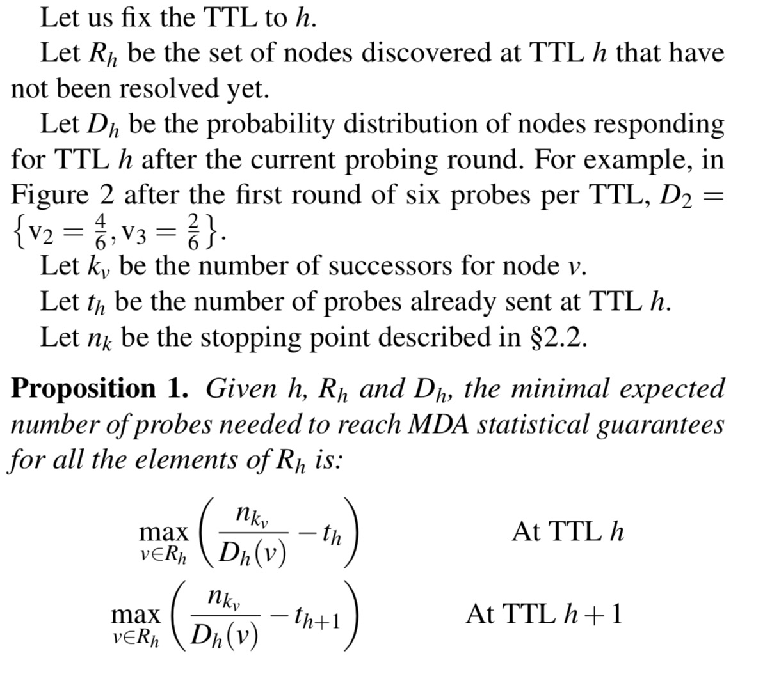

Slide 46
Key Ideas
No more resolving nodes TTL per TTL, resolves all the nodes concurrently
Round based algorithm:
Input: topology discovered by the previous round
Output: number of probes to send per TTL to achieve statistical guarantees if there was nothing more to discover

Slide 47
Scaling Diamond-Miner
Perform the algorithm on all the /24s in parallel
No more hop by hop probing constraints
Encode all the information needed to reconstruct the topology in the probes
→ Decreases the time to resolve all the /24
Notes:
We have shown the algorithm on a /24 prefix
We are no more limited by the hop by hop probing design

Slide 48
Roadmap
Challenges
Diamond-Miner
Evaluation
Limited Ltd.
Conclusion

Slide 49
Single vantage point, high probing rate
1 x 100,000 pps
Internet
Notes:
We have deployed the D-Miner on one machine at Sorbonne Université, and we have limited ourselves to 100 thousands packets per second.

Slide 50
Evaluation (Number of rounds)
10 rounds → > 99% of resolved /24 prefixes
Notes:
Here we have evaluated Diamond Miner capacity to resolve the prefixes. On X axis you have the number of rounds, and on the Y axis the CDF of the resolved prefixes. We show the results of 3 snapshots of D-Miner that have been taken during a week
We can see that 10 rounds are enough to resolve more than 99% of the prefixes.
The result of this graph is that Diamond-Miner manages to obtain the same statistical guarantees as the classic multipath algorithm.

Slide 51
Probes sent and time to completion from a single vantage point for one snapshot
 | Probes (billions) | Time to completion
Classic multipath (emulated) | 5.9 B | 64.3 years
Diamond-Miner | 6.6 B | 2.5 days
Notes:
This second result shows the tradeoff between the overhead in terms of probes compared to the time of completion
We see that for a 12% more probes, you can dramatically reduce the time to completion going from 64 years to 2.5 days.
The 64 years are based on an estimation that we’ve made given the most recent survey of IP load balancing in our last IMC 2018 paper over 350 thousands destinations.
Overhead can be due to ICMP rate limiting, or details of the algorithm, reached destination.

Slide 52

Multiple vantage points
Internet
PlanetLab Europe
6 x 10,000 pps
Notes:
Another aspect of the evaluation is how Diamond-Miner compares with other Internet mapping systems in terms of topology discovery.
We have also deployed Diamond-Miner on 6 planet lab europe nodes at a lower rate, 10,000 pps.

Slide 53
Discovery in one week
 | Vantagepoints | Nodes (millions) | Links (millions) | Probes (billions)
Yarrp | 1 | 0.6 | 1.3 | 1.6
D-Miner | 1 | 1.3 | 4.6 | 20.1
Yarrp | 6 | 0.8 | 2.5 | 1.0
D-Miner | 6 | 1.6 | 7.1 | 13.2
Notes:
We have compared to two state-of-the art tools in Internet mapping.
Yarrp is the first tool that brought the ideas to allows fast topology mapping, and we can say it is a fast single path probing technique.
We observe that in both setups with 1 and 6 VP, Yarrp
discovers less nodes and links because of the multipath capacity turned off.

Slide 54
Discovery in one week
 | Vantagepoints | Nodes (millions) | Links (millions) | Probes (billions)
D-Miner | 6 | 1.6 | 7.1 | 13.2
Ark | ~110 | 1.9 | 4.3 | 5.9
Notes:
Ark is the system used by CAIDA, at UCSD, and performs Internet wide surveys from multiple vantage points (about 110 in 2020).
Ark is also using a single path technique.
It is the state-of-the-art system in terms of Internet Wide surveys.
A survey consists in performing single path Paris traceroute to one random destination per /24.
As we saw at the beginning of the talk, the consequence of this method is that across multiple surveys, Ark is capable of detecting some diamonds.
But it does not give any statistical guarantees on this diamond discovery.
Our explanation on the number of links is that D-Miner discovers a lot more links that Ark because of the prevalence of the load balanced paths.
And Ark is still discovering more nodes because of its number of vantage points.

Slide 55
Roadmap
Challenges
Diamond-Miner
Takeaways
Limited Ltd.
Conclusion

Slide 56
Takeaways
First system capable of tracing diamonds at Internet scale with statistical guarantees
Obtains the most complete IP-level topology view from a single server
The system is in production at Sorbonne Université

Slide 57
Presentations
Université de Liège (Benoit Donnet, 2020)
Université de Strasbourg (Cristel Pelsser, 2020)
NSDI (2020)
Berkeley University (Vern Paxson, Nicholas Weaver, 2020)
Google (Christophe Diot, 2020)
Columbia University (Ethan Katz-Basset, 2020)

Slide 58
Roadmap
Challenges
Diamond-Miner
Limited Ltd.
Conclusion

Slide 59
IP level topology
VP
VP
/24
TTL 1
TTL 2
TTL 3
TTL 4
TTL 5

Slide 60
Router level topology
VP
VP
/24
TTL 1
TTL 2
TTL 3
TTL 4
TTL 5

Slide 61

Alias Resolution Based on ICMP Rate Limiting
Kévin Vermeulen, Burim Ljuma, Vamsi Addanki,
Matthieu Gouel, Olivier Fourmaux,
Timur Friedman, Reza Rejaie

Slide 62

Notes:
What are those traces?
Those traces correspond to 10 different routers responding, and non responding, to ICMP echo request, or ping, packets.
Black strokes correspond to responses, and white stroke correspond to non response.
Why aren’t they responding all the time? Because they are under ICMP rate limiting.

Slide 63
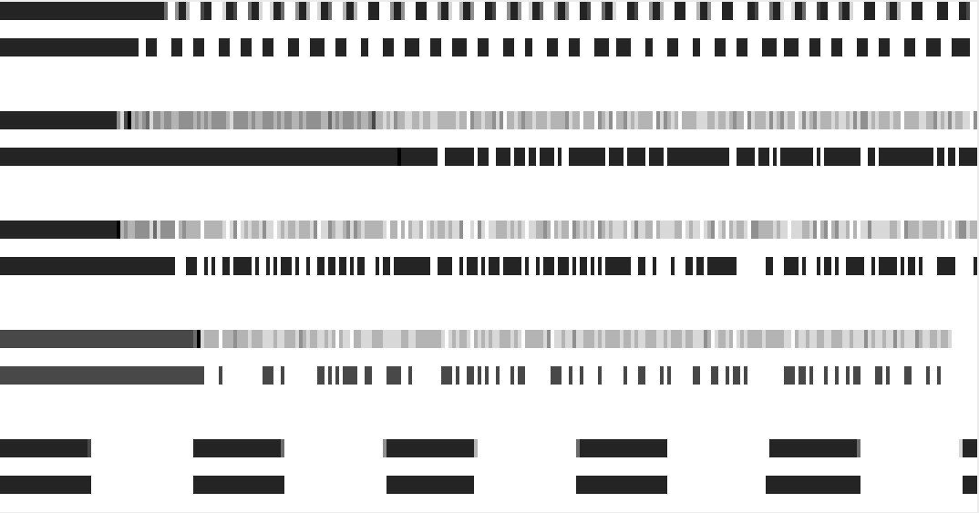
Notes:
What is the relationship with alias resolution?
Well, if you look at those traces, it shows five pairs of alias interfaces probed while the router is under ICMP rate limiting.
And you can see that there is definitely a shared behavior between each pairs
We present Limited Ltd. today that leverage this observation to build an alias resolution system.

Slide 64
ICMP rate limiting
VP
a
ICMP echo request
ICMP echo reply
Notes:
animation implies that there is a stop and wait behavior – a new probe is only sent when a reply has been received

Slide 65
ICMP rate limiting
VP
a
128 pps
128 pps

Slide 66
ICMP rate limiting
ICMP rate limiting: 500 pps
VP
a
1024 pps
500 pps
Losses because of ICMP rate limiting

Slide 67
ICMP rate limiting
Limits the number of ICMP packets sent or received by the router
Prevents DDOS attacks
Mandatory in IPv6

Slide 68
Contributions
ICMP rate limiting → alias resolution
Limited Ltd. extends the spectrum of routers that can be tested for alias resolution:
Significant improvement in IPv6
Completements existing techniques in IPv4

Slide 69
Roadmap
Challenges
Diamond-Miner
Limited Ltd.
State of the art
Conclusion

Slide 70
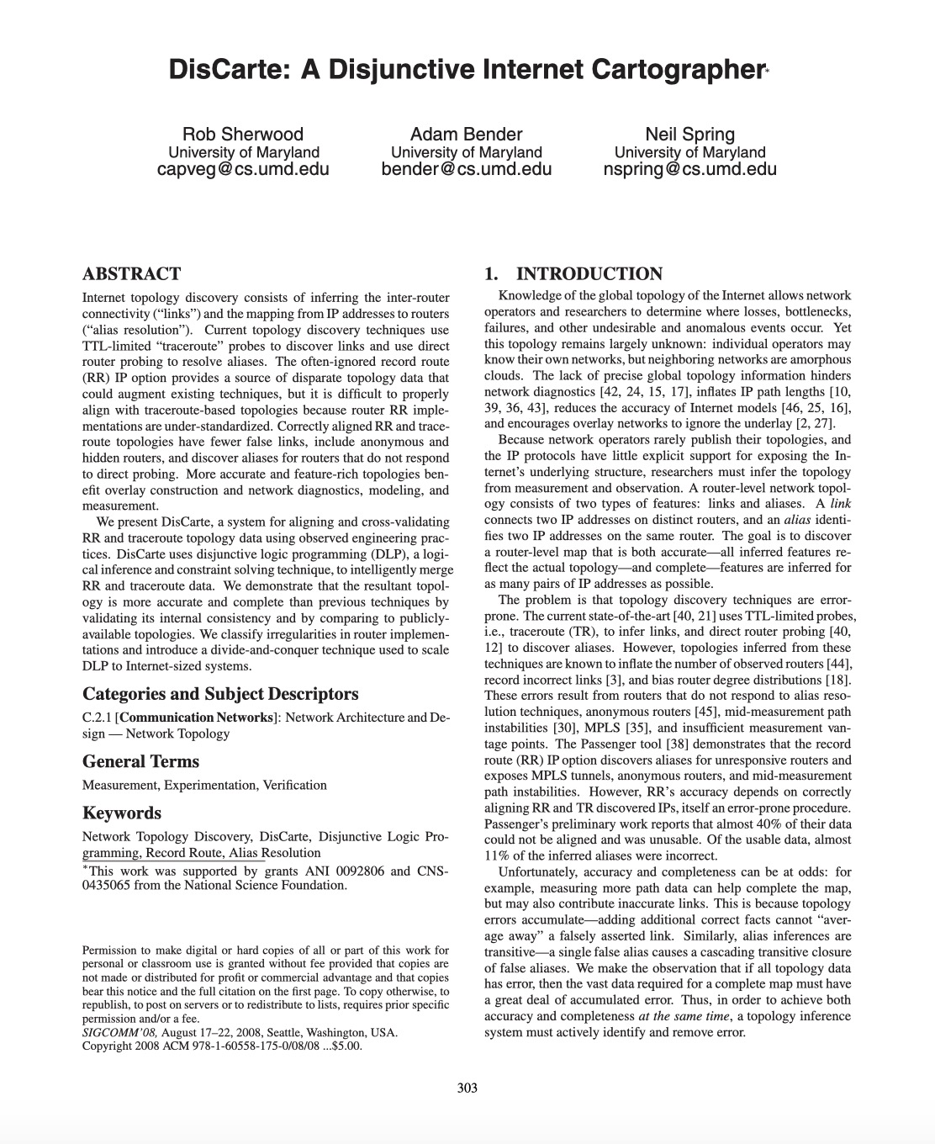
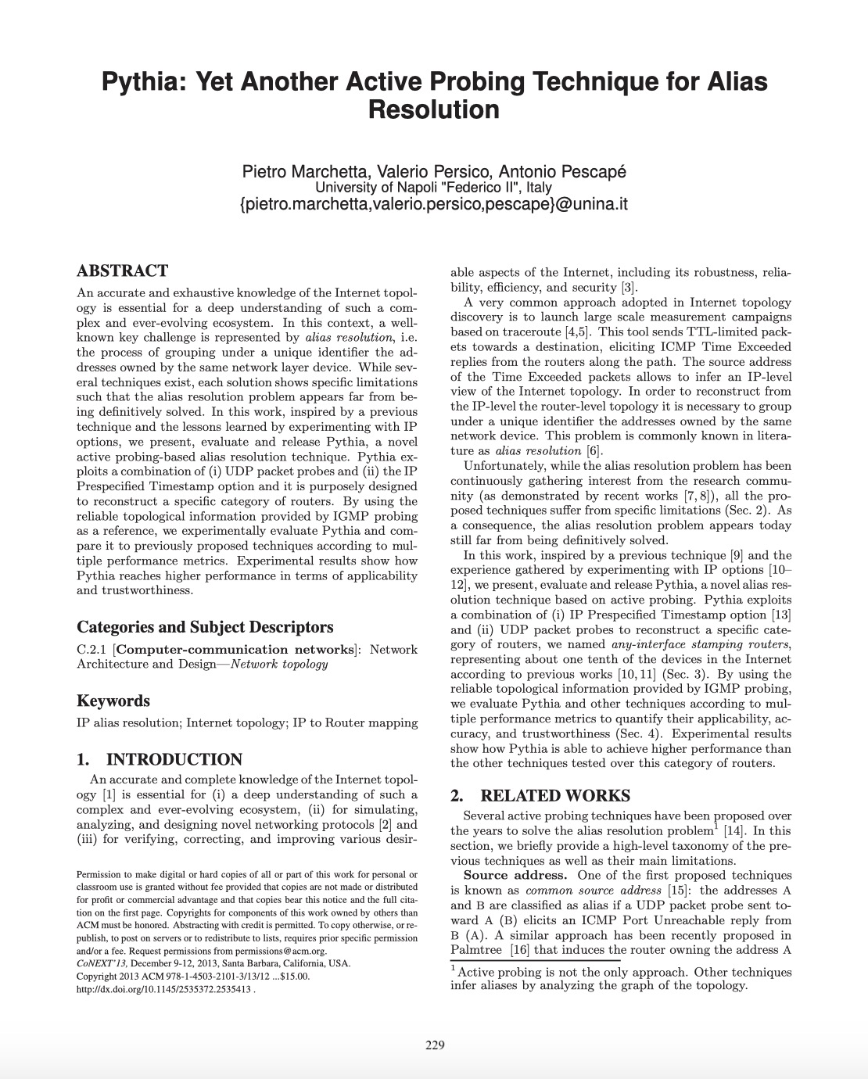
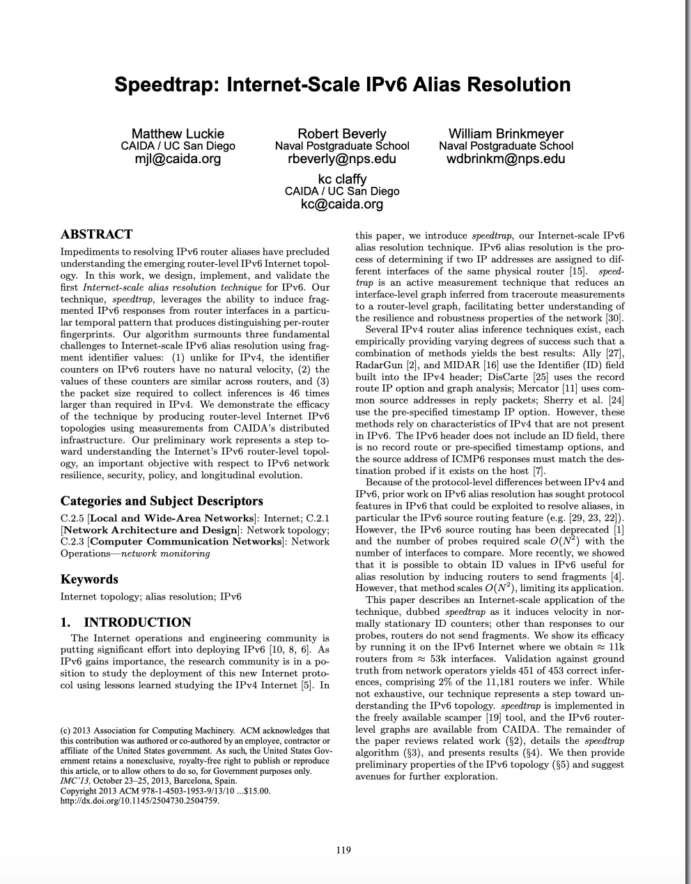
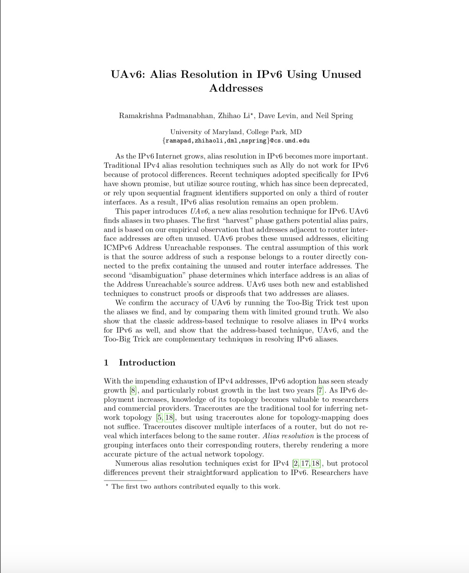
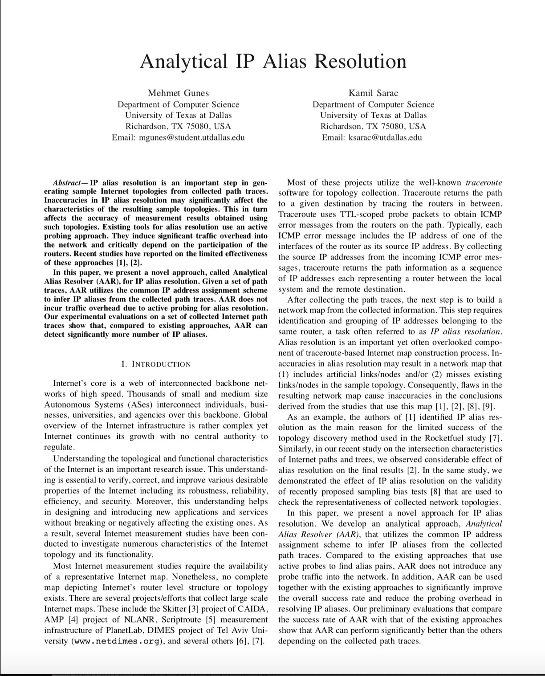
Notes:
Is it really possible to make a contribution in this area, given all the work that has been done?

Slide 71
Alias resolution techniques
Signature:
Common source IP address (Mercator)
IP ID (Ally, Radargun, MIDAR), IP fragmentation identifier (Speedtrap)
IP timestamp option (Pythia)
Topology:
Topology analysis (APAR, kapar)
Record route option (Discarte)
Other:
Reverse DNS
Notes:
slides 11-12-13 can make into more of an animation that builds

Slide 72
Alias resolution techniques: tool available
Signature:
Common source IP address (Mercator)
IP ID (Ally, Radargun, MIDAR), IP fragmentation identifier (Speedtrap)
IP timestamp option (Pythia)
Topology:
Topology analysis (APAR, kapar)
Record route option (Discarte)
Other:
Reverse DNS
Notes:
slides 11-12-13 can make into more of an animation that builds

Slide 73
Alias resolution techniques: tool available, high precision
Signature:
Common source IP address (Mercator)
IP ID (Ally, Radargun, MIDAR), IP fragmentation identifier (Speedtrap)
IP timestamp option (Pythia)
Topology:
Topology analysis (APAR, kapar)
Record route option (Discarte)
Other:
Reverse DNS
Only 2 tools meeting these criteria!
Notes:
slides 11-12-13 can make into more of an animation that builds

Slide 74
Limitation of available tools
MIDAR (IPv4):
IP ID has been shown to be a potential vulnerability for fingerprinting
Speedtrap (IPv6):
Not applicable to Juniper routers

Slide 75
Limitation of available tools
MIDAR (IPv4):
IP ID has been shown to be a potential vulnerability for fingerprinting
Speedtrap (IPv6):
Not applicable to Juniper routers
Limited Ltd. (IPv4 and IPv6):
ICMP rate limiting signature → independent of IP ID
Works on Juniper routers

Slide 76
Roadmap
Challenges
Diamond-Miner
Limited Ltd.
Algorithm
Conclusion

Slide 77
Limited Ltd.
Input: set of IP addresses
Output: set of alias sets
Key idea: ICMP rate limiting is shared by IP interfaces of a router
Notes:
can you illustrate this? « key idea » should perhaps be illustrated
If you push an interface in a rate limited state, the others will be limited as well

Slide 78
Limited Ltd.: key idea
ICMP rate limiting: 500 pps
b
VP
a
600 pps on a
20 pps on b
500 pps
a + b
Losses on a and b
Notes:
Would it help to show the paths?
Can you illustrate the role of the control interfaces?

Slide 79
Limited Ltd.
Select one interface a from the input set
Find probing rate to trigger a loss rate λ within [⍺,β]

Slide 80
Limited Ltd.: find the triggering rate
[⍺,β] = [5%,10%]
ICMP rate limiting: 500 pps
VP
a
64 pps
64 pps
λ = 0
λ < ⍺ → Doubling probing rate
Notes:
Mimicked TCP slow start algorithm

Slide 81
Limited Ltd.: find the triggering rate
[⍺,β] = [5%,10%]
ICMP rate limiting: 500 pps
VP
a
128 pps
128 pps
λ = 0
λ < ⍺ → Doubling probing rate

Slide 82
Limited Ltd.: find the triggering rate
[⍺,β] = [5%,10%]
ICMP rate limiting: 500 pps
VP
a
256 pps
256 pps
λ = 0
λ < ⍺ → Doubling probing rate

Slide 83
Limited Ltd.: find the triggering rate
[⍺,β] = [5%,10%]
ICMP rate limiting: 500 pps
VP
a
512 pps
500 pps
λ = 2.4%
λ < ⍺ → Doubling probing rate

Slide 84
Limited Ltd.: find the triggering rate
[⍺,β] = [5%,10%]
ICMP rate limiting: 500 pps
VP
a
1024 pps
500 pps
λ = 51.1%
λ > β → Binary search

Slide 85
Limited Ltd.: find the triggering rate
[⍺,β] = [5%,10%]
ICMP rate limiting: 500 pps
VP
a
544 pps
544 pps
λ = 8.1%
544 pps is the triggering rate

Slide 86
Limited Ltd.
Select one interface a from the input set
Find probing rate to trigger a loss rate λ within [⍺,β] on a
Probe a with its triggering rate, all of the others with a low rate, generate loss traces

Slide 87
Limited Ltd.: find aliases of a
ICMP rate limiting: 500 pps
Losses could occur elsewhere
b
VP
a
544 pps on a
20 pps on b
20 pps on c
500 pps
a + b
c
20 pps
c
Losses on a and b, no loss on c
Notes:
Would it help to show the paths?
Can you illustrate the role of the control interfaces?

Slide 88
Limited Ltd.: find aliases of a, with control interfaces
ICMP rate limiting: 500 pps
b
VP
d
a
544 pps on a
20 pps on b
20 pps on d
500 pps
a + b
Losses on a and b, no loss on d
Notes:
crowded slide
might want to break out a separate animation to describe what is meant by a control

Slide 89
Limited Ltd.: find aliases of a, with control interfaces
ICMP rate limiting: 500 pps
b
VP
d
a
544 pps on a
20 pps on b
20 pps on c
20 pps on d
20 pps on e
500 pps
a + b
e
c
20 pps
c
Losses on a and b, no loss on c, d, e
Notes:
crowded slide
might want to break out a separate animation to describe what is meant by a control

Slide 90
Limited Ltd.
Select one interface a from the input set
Find probing rate to trigger a loss rate λ within [⍺,β] on a
Probe a with its triggering rate, all of the others with a low rate, generate loss traces
Classify loss traces (not detailed)

Slide 92
Limited Ltd.: classify loss traces
No easy solution to classify alias/non alias pairs
Machine learning solution

Slide 93
Limited Ltd.: classify loss traces, dataset
Run multipath traceroute:
25,172 IPv4 addresses
18,346 IPv6 addresses
MIDAR/Speedtrap for labeling
« Alias » label: alias pairs
« Non alias » label: dealing with false negatives, conservatively take pairs of IP addresses found at 6 hop away from each other

Slide 94
Limited Ltd.: classify loss traces, dataset
Labeled dataset:
2,277 IPv4 alias sets
1,099 IPv6 alias sets
Form heterogeneous sets of alias/non alias IP addresses

Slide 96
Limited Ltd.: classify loss traces, features
Loss rate: 50%
Change point
Transition matrix:
Correlation: 1
0.99 | 0.01
0.01 | 0.99

Slide 97
Limited Ltd.: classify loss traces, classifiers

Slide 98
Limited Ltd.
Select one interface a from the input set
Find probing rate to trigger a loss rate λ within [⍺,β] on a
Probe a with its triggering rate, all of the others with a low rate, generate loss traces
Classify loss traces (not detailed)
Pull out a and its aliases
Repeat

Slide 99
Roadmap
Challenges
Diamond-Miner
Limited Ltd.
Evaluation
Conclusion

Slide 100
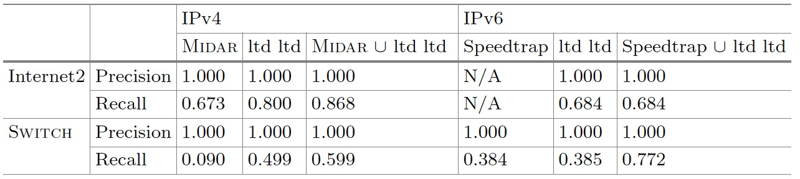
Evaluation: Ground truth

Slide 101
Evaluation: number of packets sent
Limited Ltd.: 15.5M
Midar: 168.5k
Speedtrap: 118.7k

Slide 102
Evaluation
Limited Ltd. advantages:
High precision technique
Opens a new class of routers for alias resolution in IPv6
Complements existing techniques for IPv4 and IPv6
Limited Ltd. tradeoff:
High overhead

Slide 103
Roadmap
Challenges
Diamond-Miner
Limited Ltd.
Ethics
Conclusion

Slide 104
Ethics: CPU overhead, operators feedback
SWITCH, Cisco routers:
NCS 55A1: No observable change
ASR 9001: No observable change
ASR-920-24SZ-M: 29%
SURF_{NET}, Juniper routers:
MX240: 2% on MPC
MX204: 4% on MPC

Slide 105
Ethics: CPU overhead, lab experimentation
On > 10 years old routers
No impact on dataplane nor control plane
40% maximum overhead

Slide 106
Ethics: Limited Ltd. design
Minimal probing rate to trigger a loss rate in [5%,10%]
→ Minimum of disruption to other measurements
Probing during maximum ~1 minute/router

Slide 107
Roadmap
Challenges
Diamond-Miner
Limited Ltd.
Takeaways
Conclusion

Slide 108
Takeaways
ICMP rate limiting → alias resolution
Limited Ltd. extends the spectrum of routers that can be tested for alias resolution:
Great improvement in IPv6
Completements existing techniques in IPv4
Notes:
This work has been published at PAM 2020

Slide 109
Presentations
AIMS (CAIDA, 2019)
Naval Postgraduate School (Robert Beverly, 2019)
University of Oregon (Reza Rejaie, 2019)
PAM (2020)

Slide 110
Roadmap
Challenges
Diamond-Miner
Limited Ltd.
Conclusion

Slide 111
Publications and presentations
Multilevel MDA-Lite Paris Traceroute (IMC 2018):
AIMS workshop (CAIDA, 2017)
IETF (IRTF MAP-RG, 2017)
RIPE77 (MAT-WG, 2018)
IMC (2018)

Slide 112
Publications and presentations
Limited Ltd. (PAM 2020):
AIMS (2019)
Naval Postgraduate School (2019)
University of Oregon (2019)
PAM (2020)

Slide 113
Publications and presentations
Diamond-Miner (NSDI 2020):
Université de Liège (2020)
Université de Strasbourg (2020)
NSDI (2020)
Berkeley University (2020)
Google (2020)
Columbia University (2020)

Slide 114
Community
All our code is available:
https://gitlab.planet-lab.eu/cartography/
https://github.com/dioptra-io

Slide 115
Future work
IP level topology
Reappraising structural properties
Adapting Diamond-Miner on nodes of different capacity
Revealing MPLS tunnels at Internet scale
IPv6
Notes:
Talk about EdgeNet
Pre clustering

Slide 116
Future work
Router level topology
Improving Limited Ltd. scalability
Pre-clustering for alias resolution
Notes:
Pre clustering

Slide 117
Future work
Dynamics
Geolocation (submitted to IMC 2020)

Slide 118
Thanks for your attention Questions?
Notes:
Talk about EdgeNet
Pre clustering

Slide 119

Laboratory Affiliations
Kevin Vermeulen, Burim Ljuma, Vamsi Addanki, Matthieu Gouel, Olivier Fourmaux, and Timur Friedman are associated with Sorbonne Université, CNRS, Laboratoire d’informatique de Paris 6, LIP6, F-75005 Paris, France.
Kevin Vermeulen and Timur Friedman are associated with the Laboratory of Information, Networking and Communication Sciences, LINCS, F-75013 Paris, France.
Reza Rejaie is associated with the department of Computer Science of University of Oregon

Slide 120
Laboratory Affiliations
Kevin Vermeulen, Olivier Fourmaux, and Timur Friedman are associated with Sorbonne Université, CNRS, Laboratoire d’informatique de Paris 6, LIP6, F-75005 Paris, France.
Kevin Vermeulen and Timur Friedman are associated with the Laboratory of Information, Networking and Communication Sciences, LINCS, F-75013 Paris, France.
Justin P. Rohrer and Robert Beverly are associated with the department of Computer Science of Naval Postgraduate School.

